Slide 1

FINDING THE OPTIMAL LOCATION FOR A BUSINESS
Fotina Nataliya Coursera_Applied Data Science Capstone course

Slide 2
Main steps for location determination
This project initiated for determination a location for starting a business in London city area.
Fetch the data
Extraction the necessary data from Foursquare API and Wikipedia enthnic groups in London webpage
Work on data
Clustering the boroughs in London based on their similarities in venues
Extract insights from the data
Analyze the results and extract accurate conclusion based on the analysis

Slide 3
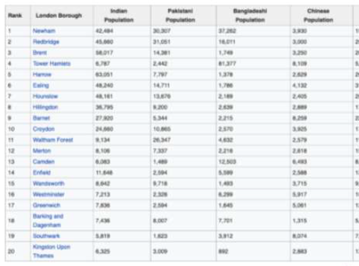
Distribution of various Asian ethnic groups in London
The data that was used contained the information about distribution of various Asian ethnicities with respect to their location in London:

Slide 4
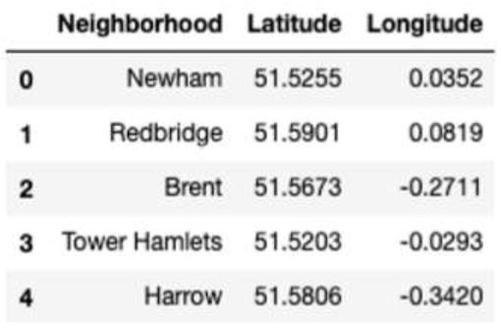
Foursquare API
Location data was appended to the scraped data in order to access Foursquare API.
Second DataFrame was created with neighborhood names.
Information about latitude and longitude of each neighbourhood was added to dataframe.

Slide 5
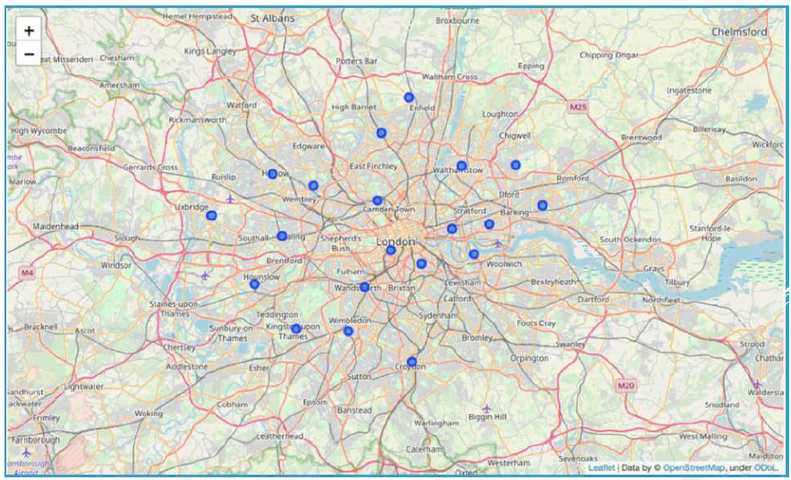
London map
The map was generated consisting of all the neighborhoods

Slide 6
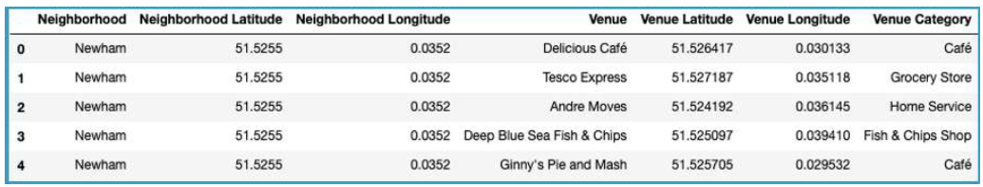
Venues by neighborhood
Neighboring objects by category were found in relation to each borough. Nearby venues was organized in using location data.

Slide 7
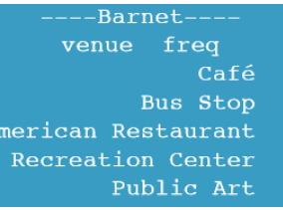
Frequency of occurrence
Nearby venues for each neighborhood obtained with their frequencies of occurrences:

Slide 8
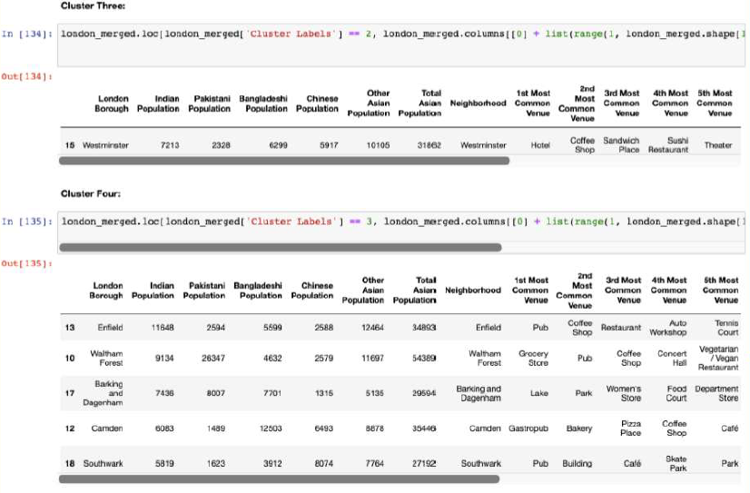
K-Means
Next were generated clusters using K-Means:

Slide 9
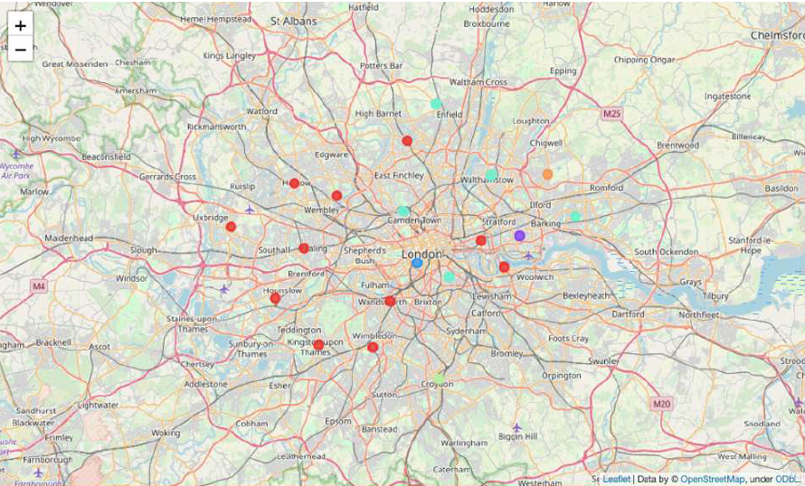
Visualization
Clusters were plotted on the map for visualization:

